Slide 1
College Basketball
Luke Nichols & Jager Springer
Group Data Analysis 2

Slide 2
Business Problem
What statistical metrics drive a successful college basketball season?
School’s conference earn $2 million for each NCAA tournament game the team appears in.

Slide 3
Who Does This Benefit?
Coaches: Improve team strategy and player development
Athletic Directors: Data-driven coaches hires and budgeting decisions
Scouts and Analyst: Identify top-performing teams and future trends.

Slide 4
Executive Summary
Main Success Drivers:
EFG_O and EFG_D
Turnover Rates
Offensive and Defensive Rebounding
Postseason Appearance

Slide 5
Dataset Overview
Kaggle NCAA College Basketball Data
Timeframe: 2013 - 2023
We filter down our data to 8 conferences
(ACC, Big East, Big Ten, Big 12, MWC, Pac-12, SEC, and WCC)

Slide 6
Dataset Overview
Original dataset had the following variables:
Continuous predictor variables:
ADJOE (Adjusted Offensive Efficiency)
ADJDE (Adjusted Defensive Efficiency)
BARTHAG
TOR (Offensive Turnover Rate)
TORD (Defensive Turnover Rate)
EFG_O (Effective Field Goal Percentage – Offense)
EFG_D (Effective Field Goal Percentage – Defense)
FTR (Free Throw Rate – Offense)
FTRD (Free Throw Rate – Defense)
ORB (Offensive Rebound Percentage)
DRB (Defensive Rebound Percentage)
2P_O (Two-Point Shot Percentage – Offense)
2P_D (Two-Point Shot Percentage – Defense)
3P_O (Three-Point Shot Percentage – Offense)
3P_D (Three-Point Shot Percentage – Defense)
ADJ_T (Adjusted Tempo)
Categorical predictor variables:
Conference
Postseason variables

Slide 7
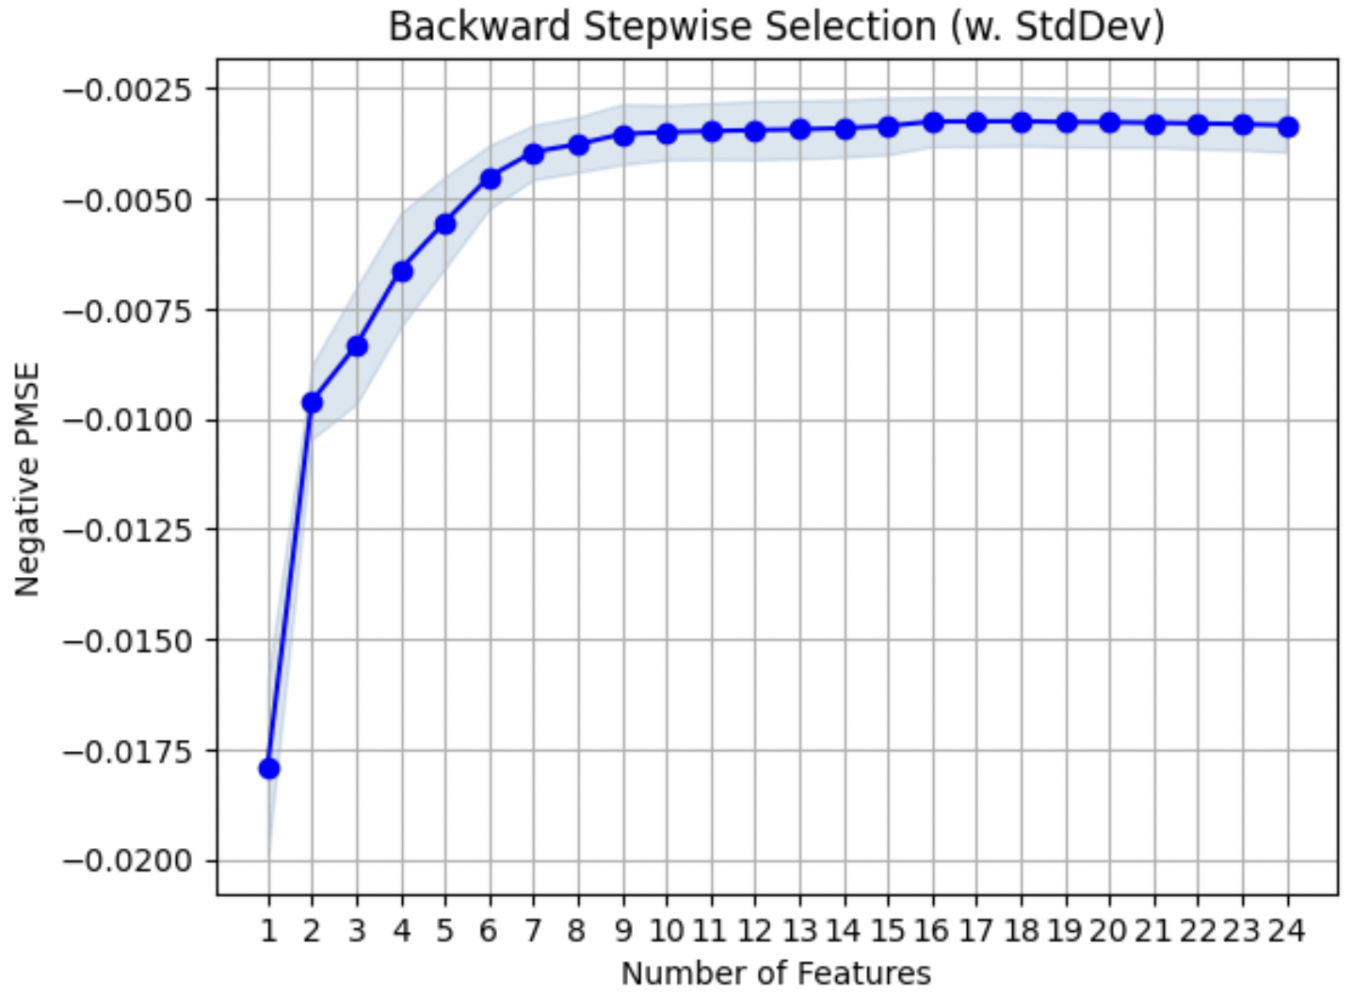
Variable Selection Methods
Using backward stepwise selection, we found our model performed very similarly with 9-24 predictor variables.

Slide 8
Dataset Overview
Combining our backward stepwise selection and elastic net results, we cut down our predictor variables to the following:
Continuous predictor variables:
BARTHAG
TOR (Offensive Turnover Rate)
TORD (Defensive Turnover Rate)
EFG_O (Effective Field Goal Percentage – Offense)
EFG_D (Effective Field Goal Percentage – Defense)
FTR (Free Throw Rate – Offense)
ORB (Offensive Rebound Percentage)
DRB (Defensive Rebound Percentage)
Categorical predictor variables:
Postseason variables:

Slide 9
Key Trends
Teams with higher shooting efficiency tend to have higher win rates
Turnovers & defensive efficiency are negatively correlated with winning
Postseason teams consistently outperform non-tournament teams

Slide 10
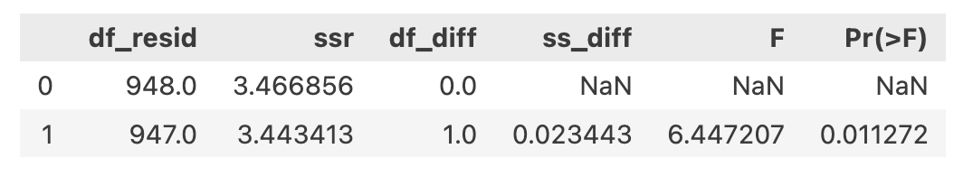
Checking for Interactions
After testing many potential interactions between predictor variables in our model, we finally decided to add an interaction between BARTHAG and our Postseason_TRUE variable as this improved our model performance.

Slide 11
Final Linear Regression Model
Expected win percentage of team that had a 0 in all of these categories is on average 48.97%.
Holding all else constant, Win percentage goes up 2.25% for every unit increase in your own effective field goal percentage and does down 2.15% for every unit increase in your opponents effective field goal percentage.
Holding all else constant, a team that makes the postseason will on average have a win percentage of 20.22% higher than a team who does not make the postseason.
Holding all else constant, a team who make the postseason will have their win percentage decrease by 16.32% on average for each one unit increase in BARTHAG.

Slide 12
Model Assumptions - Ensuring Accuracy
Checked and Passed:
Linearity: Data relationships support a linear model
Normality of Residuals: QQ plot shows no major deviations
Homoscedasticity: Residuals vs. fitted values show constant variance
Multicollinearity: No severe correlation issues between predictors
Why it matters: Ensures the model is statistically sound and business-relevant

Slide 13
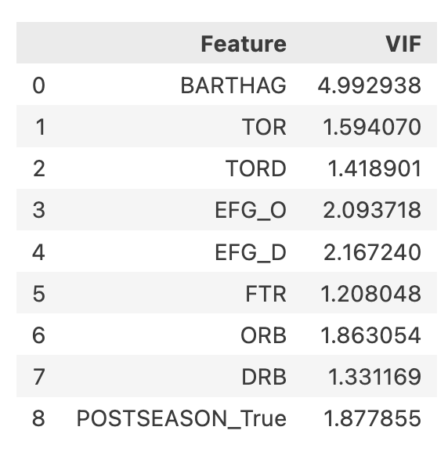
Multicollinearity
Our variance inflation factors (VIFs) overall looked very solid, with only BARTHAG having a value that could suggest multicollinearity.
In the end, we chose to keep BARTHAG in our model as we felt it would be best to include the interaction between BARTHAG and our Postseason_TRUE variable.
Future models could be explored without BARTHAG.

Slide 14
Validating Our Results
Metrics
Adjusted R² = 0.865 (Strong predictive power)
RMSE = 0.0602 (Low error margin)
F-Test: Model is statistically significant
Business Interpretation: The model is reliable enough to guide recruiting and coaching strategies

Slide 15
Predicting Utah State’s 2024-2025 Season
95% Confidence Interval: Win % between 44.3% - 73.0% (13.7 to 22.6 wins)
95% Prediction Interval: Win % between 40.0% - 77.2% (12.4 to 24.0 wins)
Utah State finished the regular season with 25 wins.

Slide 16
Business Recommendations
For Teams & Coaches:
Look at which metric your team is underperforming in and work on improving in that area of the game.
For Recruiters & Athletic Directors:
Focus on players with high shooting efficiency & strong ball control
Consider past postseason appearances when evaluating coaching performance

Slide 17
Limitations & Future Work
Limitations:
Data is limited to major and upper mid-major conferences.
No consideration of strength of schedule.
Does not include coaches in-game strategy adjustments.
Model may be overfitting slightly as it performs well in some metrics but shows high variation in some predictions.
Next Steps:
Expand to all NCAA teams.
Use strength of schedule data to better predict how metrics will influence specific matchups.

